Slide 1


Slide 2
What is TensorFlow™?
Open source software library for numerical computation using data flow graphs
Originally developed by Google Brain Team to conduct machine learning and deep neural networks research
General enough to be applicable in a wide variety of other domains as well TensorFlow provides an extensive suite of functions and classes that allow users to build various models from scratch.

Slide 3
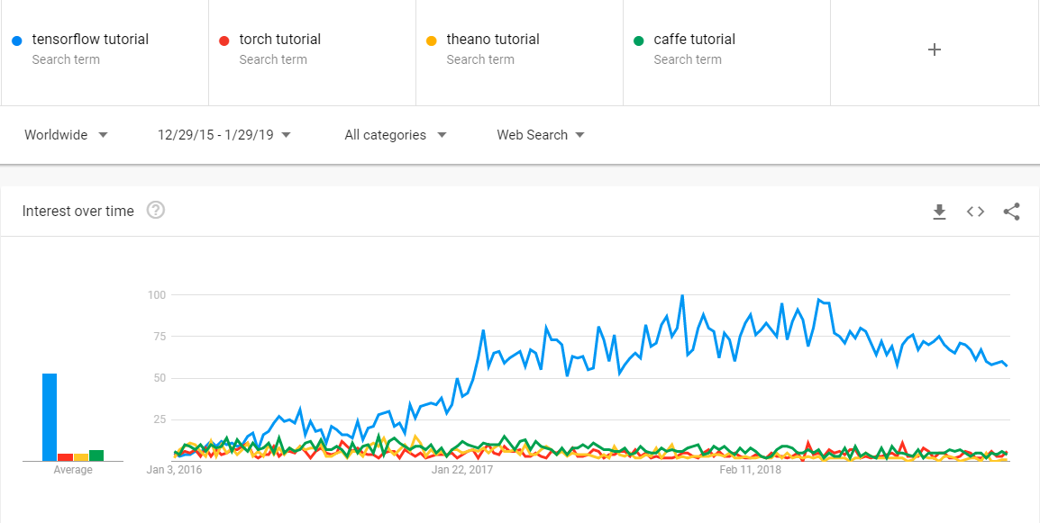
Why tensorflow ?

Slide 4
Why TensorFlow?
Python API
Portability: deploy computation to one or more CPUs or GPUs
Flexibility: from Android, iOS, Windows, Linux to server farms
Visualization (TensorBoard)
Checkpoints (for managing experiments)
Large community
Because Google !

Slide 5
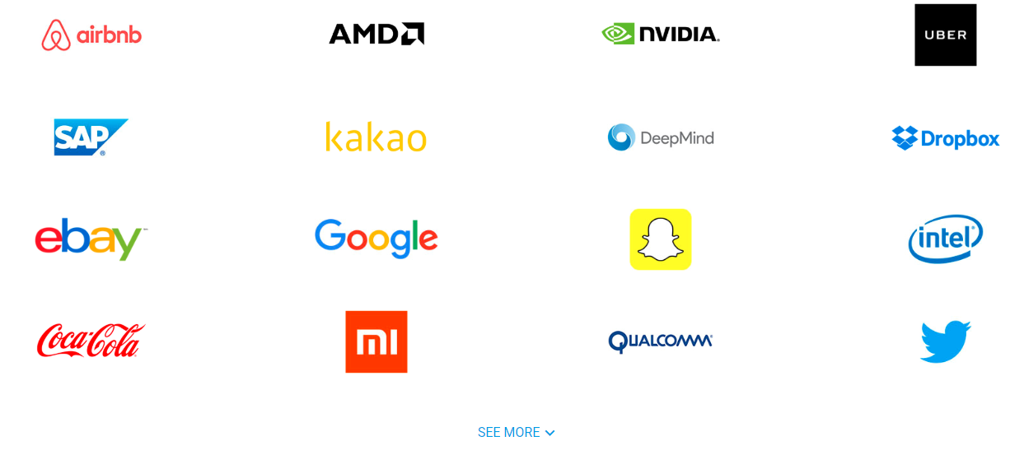
Companies using Tensorflow

Slide 6
Tensorflow Program
Construction Phase
(assemble a graph)
Execution phase
(use a session to execute operations in the graph)
Notes:
Construction – lay the pipeline, plumbing, mixed with some red dye and then some blue to give green as result
Execution – use that pipeline, actually put water and dye

Slide 7
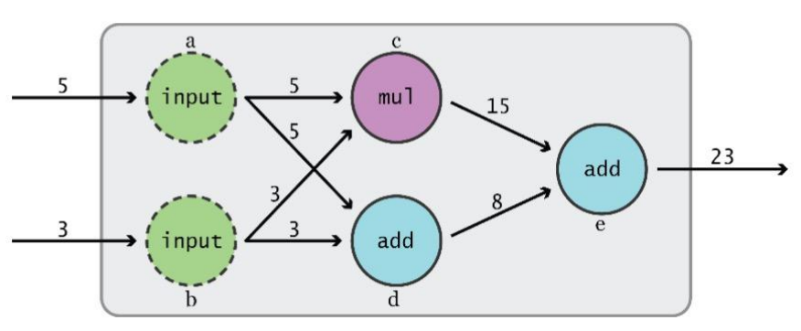
Data Flow Graphs
TensorFlow separates definition of computations from their execution

Slide 8
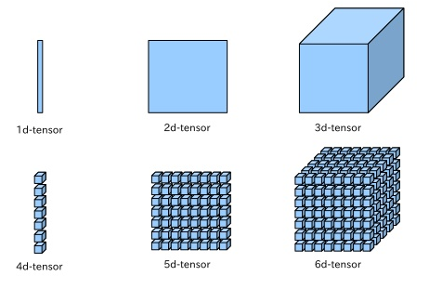
What is a tensor ?
An n-dimensional array or simply a data structure
0-d tensor: scalar (number)
1-d tensor: vector 2-d tensor: matrix
And so on

Slide 9

Tensorflow Coding Time !
C:\Users\... > jupyter notebook

Slide 10
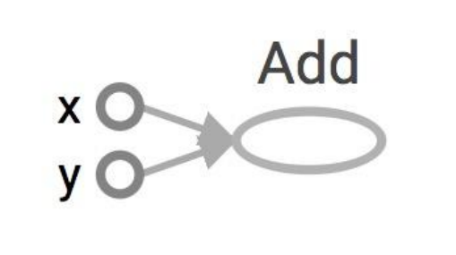
Data Flow Graphs
import tensorflow as tf
a = tf.add(3, 5)

Slide 11
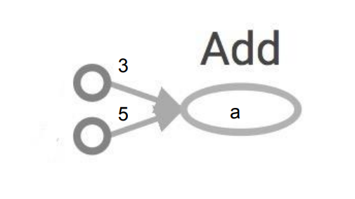
Data Flow Graphs
import tensorflow as tf
a = tf.add(3, 5)
Nodes: operators, variables, and constants
Edges: tensors Tensors are data.
Data Flow -> Tensor Flow!
Interpreted as

Slide 12
Data Flow Graphs
import tensorflow as tf
a = tf.add(3, 5)
print a
Nodes: operators, variables, and constants
Edges: tensors Tensors are data.
Data Flow -> Tensor Flow!
Interpreted as

Slide 13
Data Flow Graphs
import tensorflow as tf
a = tf.add(3, 5)
print a
>> Tensor("Add:0", shape=(), dtype=int32)
(Not 8)
Nodes: operators, variables, and constants
Edges: tensors Tensors are data.
Data Flow -> Tensor Flow!
Interpreted as

Slide 14
How to get the value of a?
Create a session, assign it to variable sess so we can call it later
Within the session, evaluate the graph to fetch the value of a

Slide 15
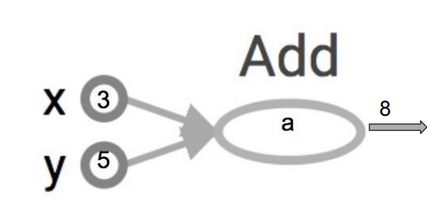
Data Flow Graphs
import tensorflow as tf
a = tf.add(3, 5)
sess = tf.Session()
print sess.run(a)
sess.close()
The session will look at the graph, and think: hmm, how can I get the value of a?
then it computes all the nodes that leads to a.

Slide 16
tf.Session()
A Session object encapsulates the environment in which Operation objects are executed, and Tensor objects are evaluated.
In a sinlge-process TF, multiple sessions don’t share any state
Session would’ve it own copy

Slide 17
Tensorflow Program
Construction Phase
import tensorflow as tf
a = tf.add(3, 5)
Execution phase
sess = tf.Session()
print sess.run(a)
sess.close()

Slide 18
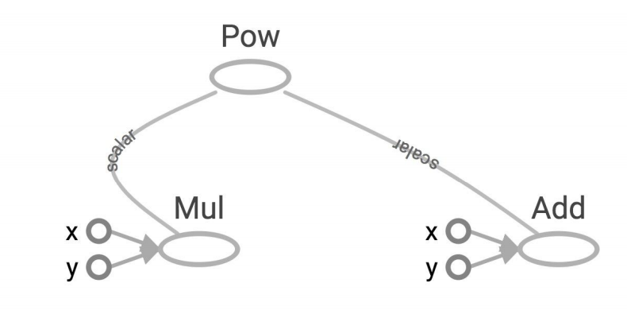
More Graphs
x = 2
y = 3
op1 = tf.add(x, y)
op2 = tf.mul(x, y)
op3 = tf.pow(op2, op1)
with tf.Session() as sess:
op3 = sess.run(op3)

Slide 19
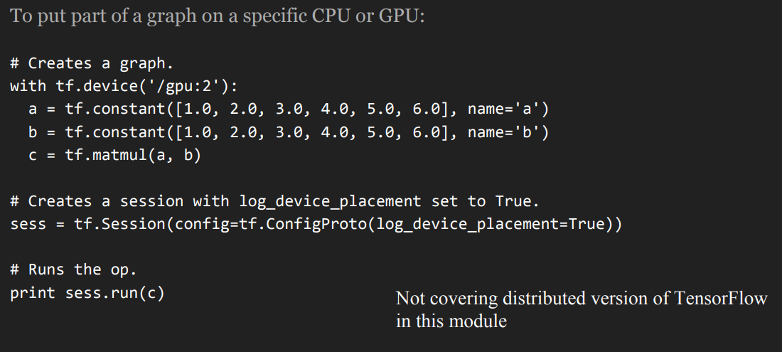
Distributed Computation ?
Possible to break graphs into several chunks and run them parallelly across multiple CPUs, GPUs, or devices

Slide 20

C:\Users\... > activate stratpyenv3

Slide 21
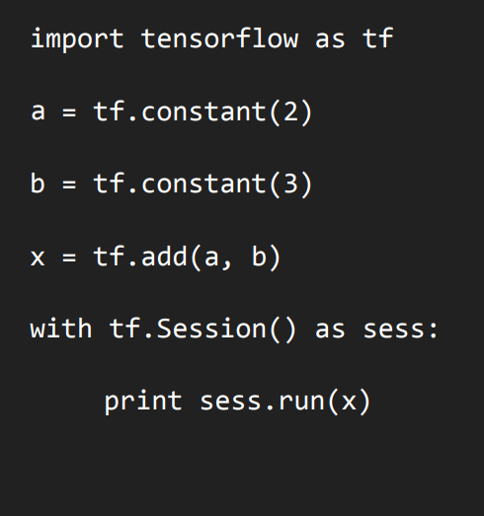
First tensorflow program

Slide 22
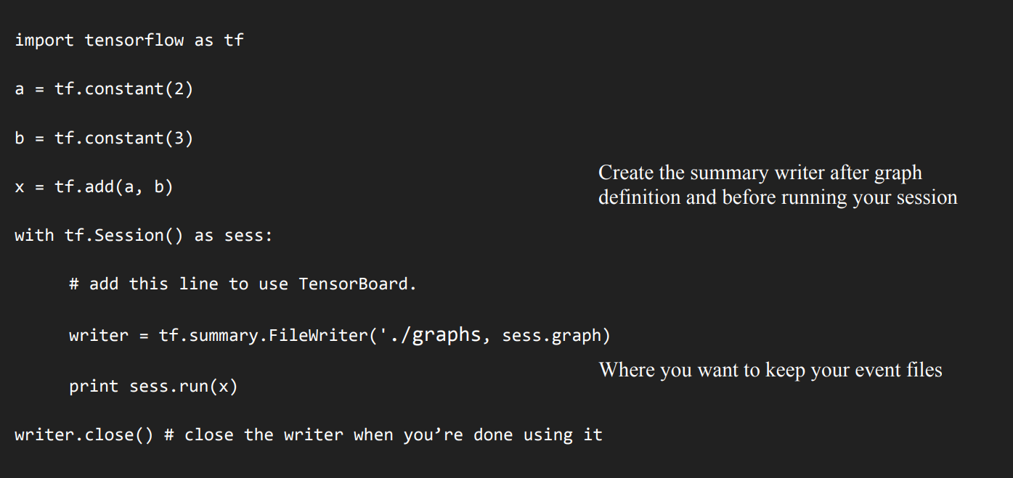
Tensorboard

Slide 23
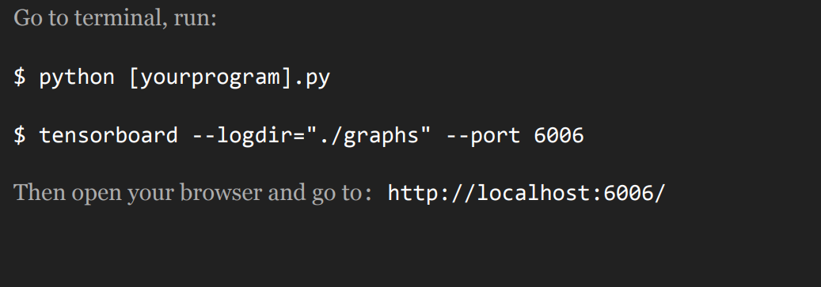
Running the program

Slide 24
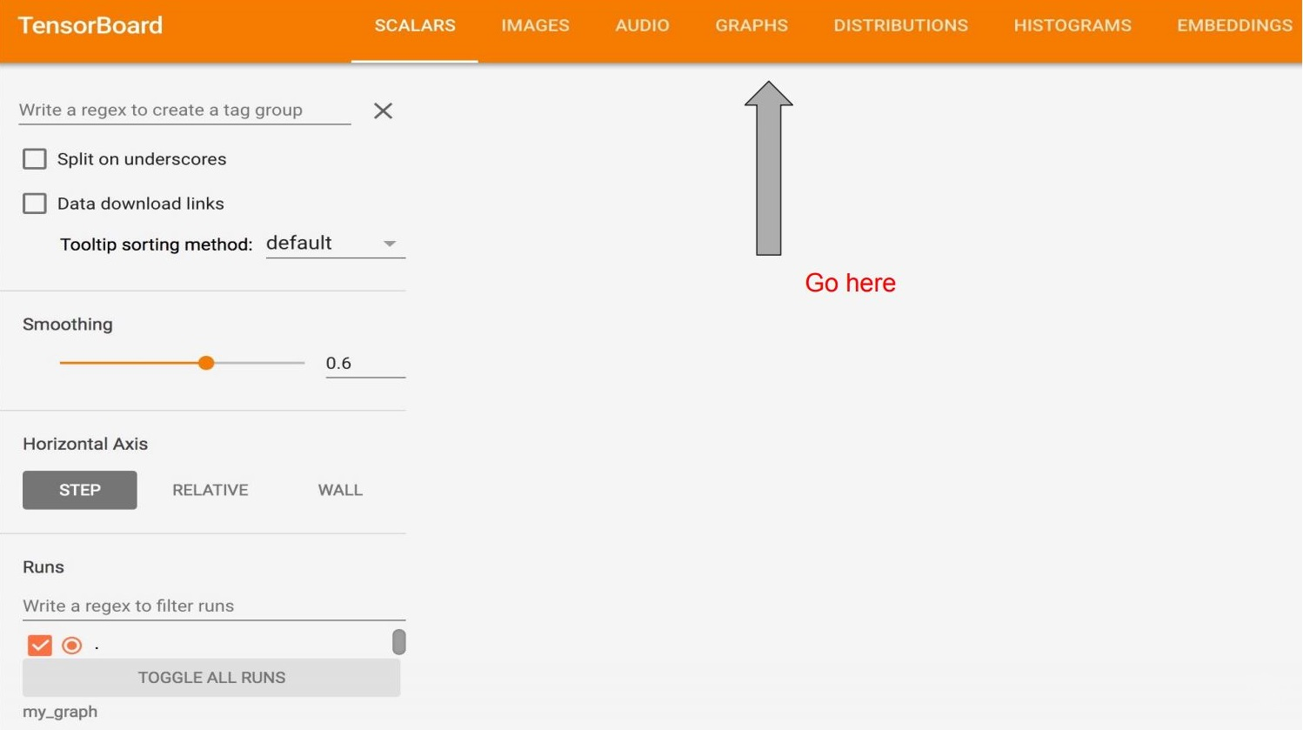

Slide 25
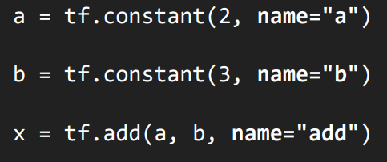
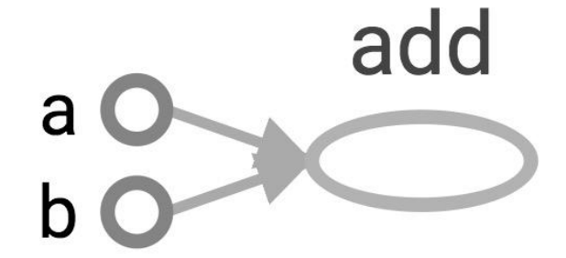
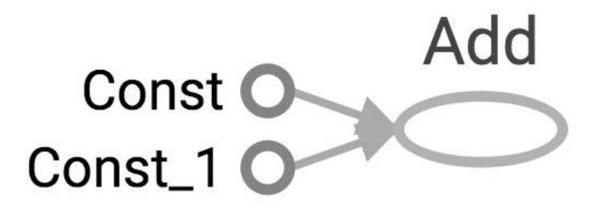
Change the variable names

Slide 26
Learn to use TensorBoard well and often. It will help a lot when you build complicated models.

Slide 27
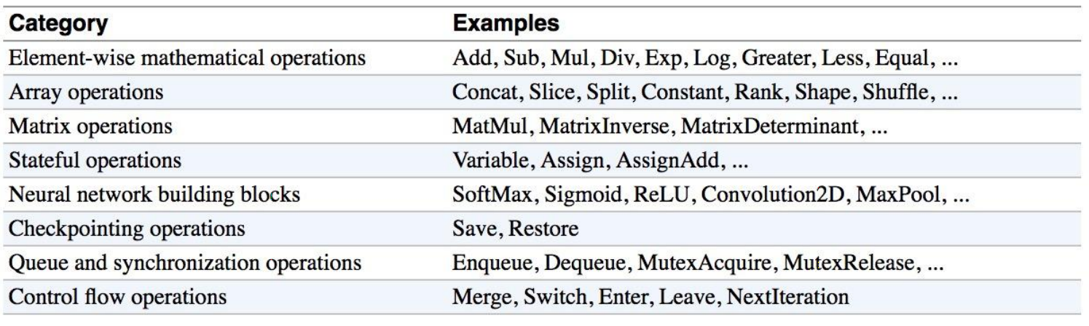
Operations

Slide 28
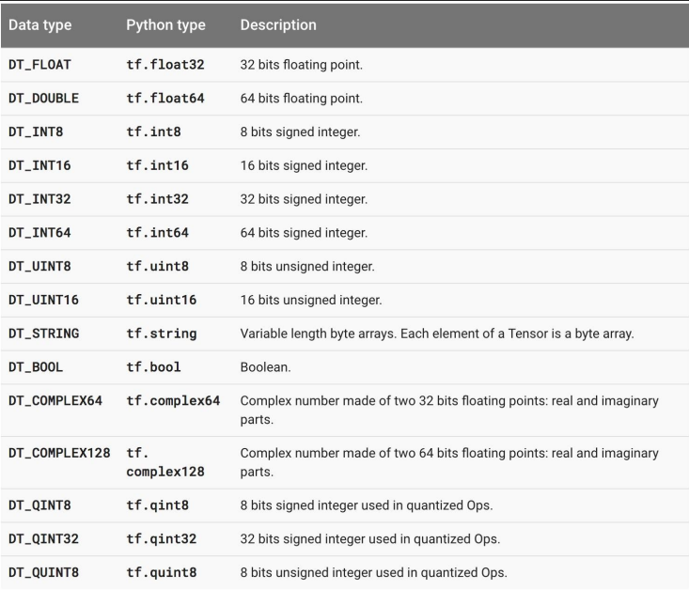
Tensorflow Datatypes

Slide 29
Practice time
Write a TF program to find cost of item after discount and visualize using tensorboard
Hint: Final_price = Current_price – (Current_price * Discount)/100

Slide 30


Slide 31

What is Keras ?
Keras is an open source neural network library written in Python.
It is capable of running on top of TensorFlow.
Designed to enable fast experimentation with deep neural networks, it focuses on being user-friendly, modular, and extensible

